Slide 1
Final Project Title
Delivering an ML/AI Strategy, AI for Business Leaders, Udacity
Student Name, Month - Year

Slide 2
Executive Summary
Purpose of Project
Assess and propose use cases which have relatively high feasibility & impact from either a efficiency and cost perspective, or direct positive impact to the customer
Companies are at a fork in the road; they can choose to be a data & AI driven business or find it tough to beat or even match their competition
Methodology
Detailed Analysis conducted over 7 weeks. Availability of data, AI capabilities and impact were key areas of analysis
5 potential use cases underwent thorough assessment through feasibility and impact lenses
Incorporated both technical knowledge and user feedback
Path Forward
2 use cases identified for implementation
The ask is for this senior stakeholder group to endorse a seed investment for the first phase of the project and champion the initiative in their respective areas
A low hanging fruit approach will be leveraged to progress with initially POCs being conducted on a small scale to prove out the viability of the proposed use cases

Slide 3
I began with five use case ideas
Quality Control Classifier
Predict whether finished goods are faulty using Computer Vision capabilities.
Vehicle Fault Predictor
Use in-car sensor data to predict faults in the car before they occur.
Machinery Uptime Booster
Reduce the cost of scheduled maintenance of machinery by simulating a digital factory and predicting faults/maintenance.
Ride Personaliser
Unlock car, and personalise car actions based on driver and driver’s emotional queues, by leveraging Facial Recognition capabilities.
Manufacturing Optimiser
Use manufacturing and other costs, in conjunction with demand prediction to predict the most optimum item to manufacture at a given time.

Slide 4
I assessed feasibility vs. impact for all cases
UC 1
Key criteria assessed
UC1 – Quality Control Classifier
UC2 – Ride Personaliser
UC3 – Vehicle Fault Predictor
UC4 – Manufacturing Optimiser
Key area 5 – Machinery Uptime Booster
UC 2
Impact
UC 3
UC 5
UC 4
Feasibility

Slide 5
Transforming our business using ML/AI with these top two use cases
Quality Control Classifier
Employ Visual Classifier AI capability to QC finished products by passing high resolution images through the Classifier.
Instead of random sampling some products by QC team, all products are checked by the AI model.
Ride Personaliser
Leverage facial recognition techniques to automatically lock/unlock the car.
Use facial recognition to also customise the car based on customer’s emotional queues.
Train model on public dataset to avoid bias.
By executing on these two projects I believe we can drive innovation for our business by leveraging AI and become a trendsetting business.

Slide 6
Quality Control Classifier Deep Dive
Process Today
Random Sampling
Microscopic defects unclear/missed
Only a subset of goods go through QC
Frequency of random sampling increased to catch more defects (not scaleable)
Example Architecture
Process Tomorrow
Labelled historical images of finished goods used to train Visual Classifier
Images of newly finished goods run through classifier to identify defects
N classifiers for top N error types
All finished goods run through AI models, not just a subset
Improved identification of Microscopic faults
The impact of the AI QC Classifier will be revolutionary thanks to new found ability to accurately catch microscopic faults and QC 100% of finished goods!

Slide 7
Ride Personaliser Deep Dive
Process Today
Keys or proximity sensors used
Manually adjust car interiors
No predictive capability in the car
Dated experience in new EV technology vehicles
Example Architecture
Process Tomorrow
Driver’s face unlocks the car, boot, hood
Driver’s customised settings automatically executed as they enter vehicle
Facial recognition also predicts drivers emotional state and customises car
Cars now use cutting edge technology and wow our customers
The impact of the ride personaliser will put our brand on the forefront thanks to rich enjoyable customer experience every ride!

Slide 8
Risks/Mitigations
 | Quality Control Classifier | Ride Personaliser
Accuracy An assessment of model performance determined by the number of correct predictions out of the total number of predictions. | Concerns: Strategy is for QC team to verify all items classified faulty in the initial phase. Microscopic errors may not be able to be verified by QC team. Plan: Make sophisticated instrumentation available and train QC team in engineering skills to verify microscopic errors. Second engineers into the QC team in initial phase. | Concerns: Only the customer drivers should be able to unlock the car. There is a risk that strangers are able to unlock the car if the model recall is low. Plan: Train models with high recall scores. Manage settings towards security (e.g. if probability of match is less than 95% don’t unlock)
Underfitting/Overfitting Model unable to capture underlying patterns OR overstates patterns in the data | Concerns: Since an approach of 50 classifiers for top 50 errors has been agreed, there is a risk that new error types go undetected. The 50 models conceptually overfit, as they are only ever looking for the specific error type. Plan: Build generic classifier which identifies the presence of fault rather than type of fault, and run through the 50 classifiers. The faulty ones which are not picked up by the 50 could be candidates for new types of errors. | Concerns: No overfitting or underfitting concerns have been raised for this use case. Plan: N/A
Ethical Concerns Model shouldn’t have unintentional discriminatory bias in its predictions. | Concerns: No ethical concerns have been identified for this use case. Plan: N/A | Concerns: Use case expands into predicting car behavior for customers (e.g. music). With the model basing predictions on facial images, there is a risk that customers may get certain recommendations on basis of age, sex, race etc. Plan: Models will be trained on public dataset of facial images and outcomes monitored for any bias or ethical issues.

Slide 9
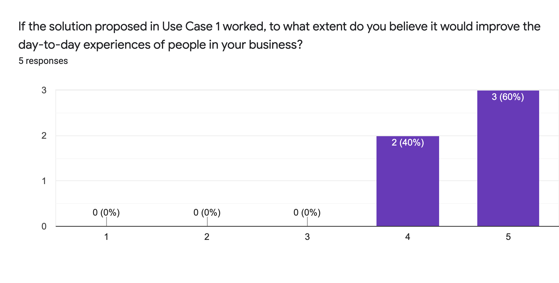
Feedback Thus Far
Proposed Next Steps
Endorse Strategy
Seek funding approval
Mobilise Proof of Concept
Illustrative Verbatim Quotes
“this use case will not only introduce cost savings into the business, but also improve our brand image with faulty goods being identified before reaching the customers”
Proposed Timeline
“something like this, can establish us as the 'Apple' of car manufacturing.”
Month 1
Business Case documented
Funding Approved
Illustrative Visualization
Month 2
QC POC with top 5 error types
Ride personaliser lock/unlock use case
Month 3
Roadmap & Estimate future phases
Update business case with detailed estimates
Funding Approval
Special Mention
We strongly believe in other use cases which can benefit our organisation. These are Vehicle Fault Predictor and Machinery Uptime Booster. We are very keen to use the learnings from the QC Classifier use case to assess how the manufacturing process can be improved and subsequently mobilise work on Machinery Uptime Booster.

